Slide 1
CSE 105 theory of computation
Fall 2020 Week 3

Slide 2
Table of Contents – Quickly Jump to a video’s slides
Monday | Wednesday | Friday
Video 28 | Video 33 | Video 37
Video 29 | Video 34 | Video 38
Video 30 | Video 35 | Video 39
Video 31 | Video 36 | Examples
Video 32 | Examples | FAQ
Examples | FAQ
FAQ

Slide 3
This week’s learning goals
Determine the language recognized by a given NFA
Design general constructions for NFA
Find equivalent DFA for a given NFA
Convert between regular expressions and automata
Choose between multiple models to prove that a language is regular
Explain the limits of the class of regular languages
Identify some nonregular sets
Justify why the Pumping Lemma is true

Slide 4
Monday
Videos 028-032
Today’s learning goals
Determine the language recognized by a given NFA
Design general constructions for NFA
Today’s textbook sections
Sipser 1.2 Theorem 1.47 and Theorem 1.49

Slide 5
028.CSE105.NFAMoreExamples.mp4
Remember:
The language of an NFA is the set of strings accepted by the NFA.

Slide 6
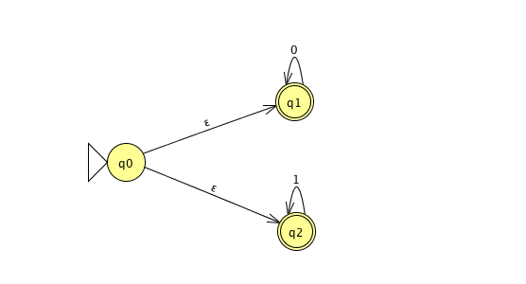
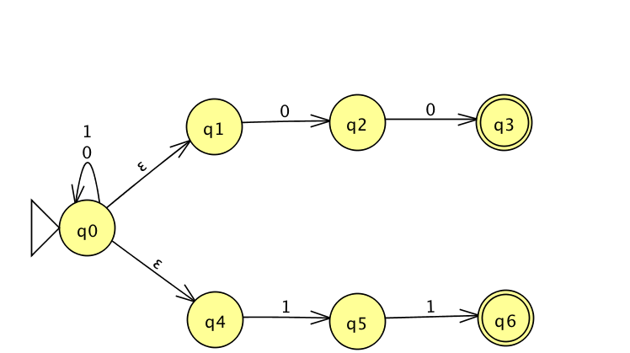
NFA
L(M1) =
L(M2) =

Slide 7
NFA ∑ = {0,1} ε ∉ ∑
“All 0s or all 1s”
“Ends with 00 or ends with 11”
L(M1) = L(0* U 1*)
= L(ε(o* U 1*))
L(M2) = L(∑*(00 U 11))

Slide 8
Key Notation and Definitions (028)
Concatenating the empty string with any set results in the same set.
ε is a label on the arrow, but it’s not in the alphabet.
As soon as the NFA has at least one computation that has processed the whole input string and ends in an accept state, the NFA accepts the string.

Slide 9
029.CSE105.NFAFormalDefinitions.mp4
Remember:
Arrows labeled with ε are spontaneous moves.

Slide 10
NFA
Formal definition of M1:
Formal definition of M2:

Slide 11
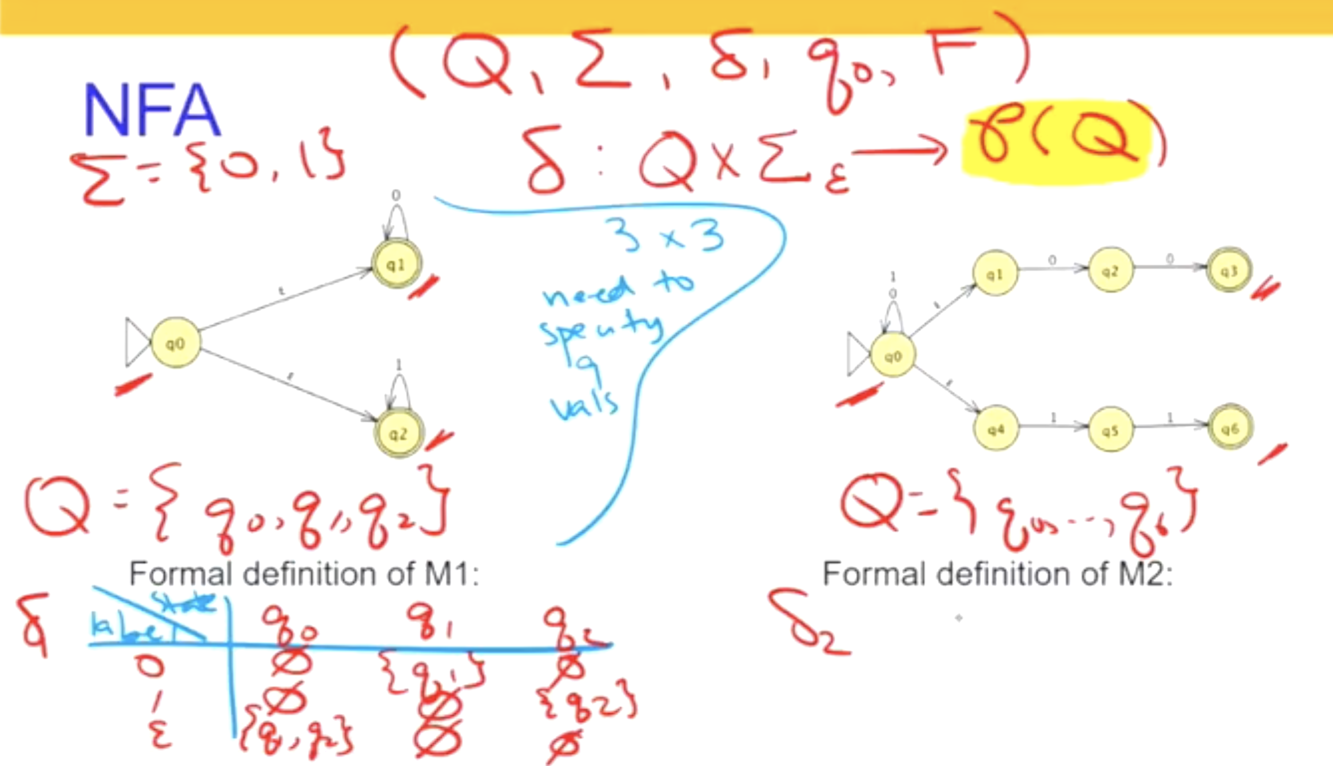

Slide 12
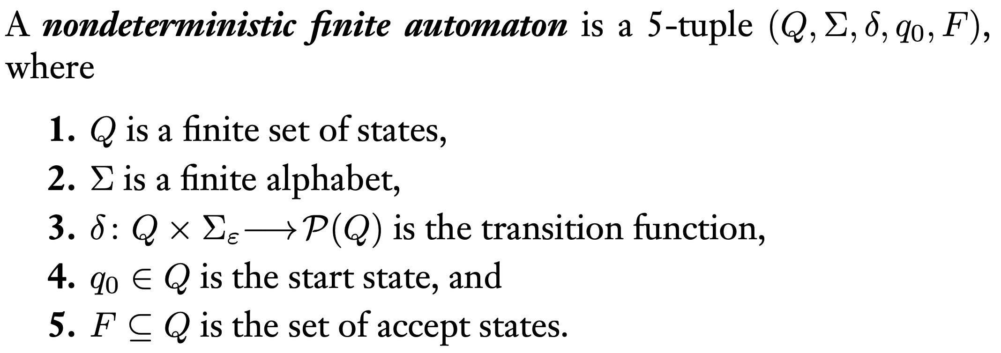
Key Notation and Definitions (029)
We need to explicitly show what the alphabet of the NFA is, since in an NFA, it is possible that not all the symbols in the alphabet will be included in transitions that we can see in the diagram.
Σ_{ε} = alphabet + ε
Def 1.37, pg.53

Slide 13
030.CSE105.RegularLanguagesUnionAgain.mp4

Slide 14
New – easier – construction for union
"Guess" one of finite list of criteria to meet
Accept if
either (or both) accepts
M1
Input
M2

Slide 15

New – easier – construction for union
"Guess" one of finite list of criteria to meet
Accept if
either (or both) accepts
M1
Input
M2

Slide 16
Key Notation and Definitions (030)
We can use NFA to construct a new machine whose language is the union of the two machines' languages.
Do this by creating a new start state and creating transitions to the start states of M1 and M2 using spontaneous moves.

Slide 17
031.CSE105.RegularLanguagesConcatenation.mp4
Remember:
DFA: has a unique computation path for each input
NFA: allows several (or zero) alternative computation paths on the same input
δ(q,x) may specify more than one possible next state
ε transitions allow the machine to transition between states spontaneously, without consuming any input symbols

Slide 18
Concatenation, formally pp. 60-61
"Guess" some stage of input at which switch modes
Given M1 = (Q1,Σ,δ1,q1,F1), M2 = (Q2,Σ,δ2,q2,F2) build
N = (…, Σ, δ, q1, F2) with δ…
Input
M2
M1

Slide 19



Concatenation, formally pp. 60-61
"Guess" some stage of input at which switch modes
Given M1 = (Q1,Σ,δ1,q1,F1), M2 = (Q2,Σ,δ2,q2,F2) build
N = (…, Σ, δ, q1, F2) with δ…
Input
M2
M1

Slide 20
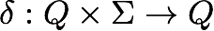
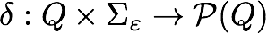
More differences between NFA and DFA
DFA: unique computation path for each input
NFA: allow several (or zero) alternative computations on same input
δ(q,x) may specify more than one possible next states
ε transitions allow the machine to transition between states spontaneously, without consuming any input symbols
Types of components of formal definition
DFA
NFA

Slide 21
Concatenation, formally pp. 60-61
δ( (q, x) ) = if q is in Q1, x is in Σ
if q is in Q2, x is in Σ
?
Input
M2
M1

Slide 22

Concatenation, formally pp. 60-61
δ( (q, x) ) = if q is in Q1, x is in Σ
if q is in Q2, x is in Σ
?
Input
M2
M1

Slide 23
Key Notation and Definitions (031)
Steps we went through in building the transition function for the NFA for concatenation:
When the input state is from M1, do what M1 would’ve done.
When the input state is from M2, do what M2 would’ve done.
If the input state is an accept state in M1, we want to spontaneously move to M2’s start state.
If the input state is a non-accept state in M1, we don’t want any spontaneous moves to M2. Hence the transition function is the empty set.
We don’t want any spontaneous moves in Q2.

Slide 24
032.CSE105.RegularLanguagesKleeneStar.mp4
Remember:
Kleene star *
If S is a set of strings, then S* is defined as the smallest superset of S that contains the empty string ε and is closed under the string-concatenation operation.
For example
{"ab","c"}* = { ε, "ab", "c", "abab", "abc", "cab", "cc", "ababab", "ababc", "abcab", "abcc", "cabab", "cabc", "ccab", "ccc", ...}
∅* = {ε}
{"a", "b", "c"}* = { ε, "a", "b", "c", "aa", "ab", "ac", "ba", "bb", "bc", "ca", "cb", "cc", "aaa", "aab", ...}

Slide 25
Star operation
ε
Input
ε
M
Given M1 = (Q1,Σ,δ1,q1,F1), build
N = ( Q1 U {q0}, Σ, δ, q0, F1 U {q0} )
and δ(q,x) = …
Construction in the book (page 63)
ε

Slide 26

Star operation
ε
Input
ε
M
Given M1 = (Q1,Σ,δ1,q1,F1), build
N = ( Q1 U {q0}, Σ, δ, q0, F1 U {q0} )
and δ(q,x) = …
Construction in the book (page 63)
ε

Slide 27
Key Notation and Definitions (032)
Idea behind the NFA we just built:
When we get to an accept state, we spontaneously move to the start state and continue to read the next part of the input string.
This makes sure that each component of the input string comes from the original language.

Slide 28
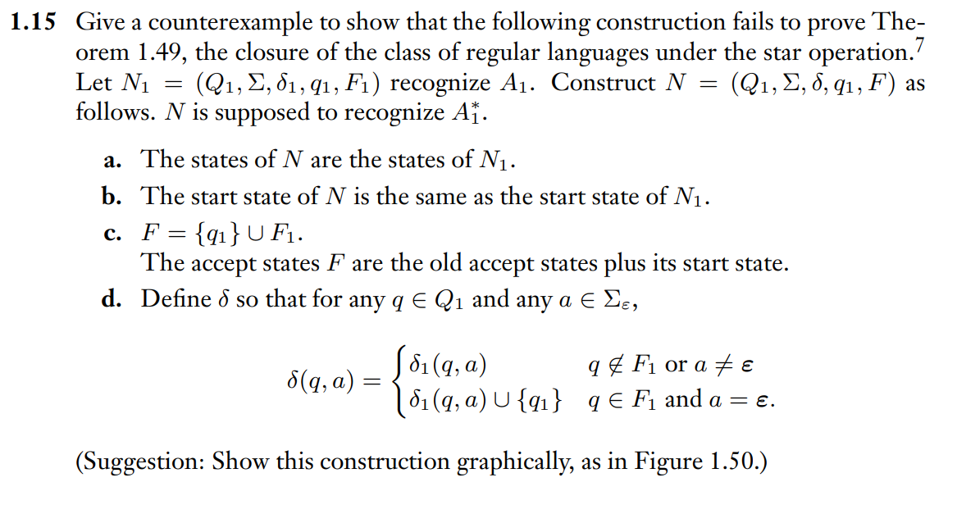
A Faulty Construction
Example 1
Ch. 1 Exercises pg. 85

Slide 29
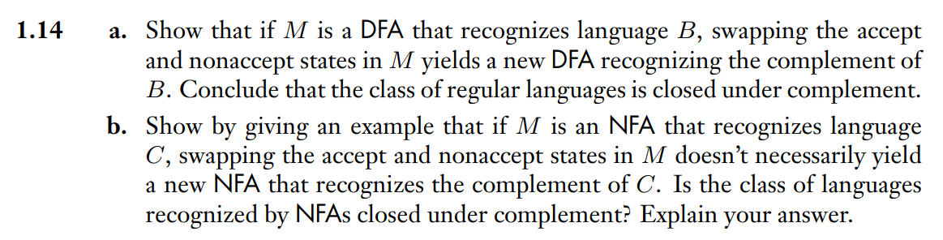
Swapping Accept and Nonaccept States
Example 2
Ch. 1 Exercises pg. 85

Slide 30
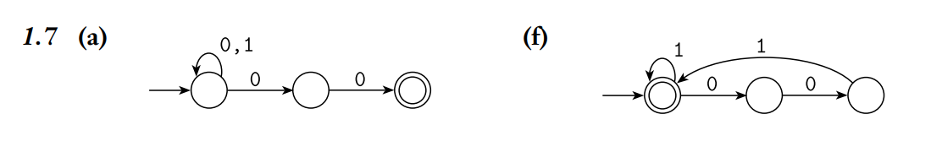
Example 1 Solution
Ch. 1 Solutions pg. 96

Slide 31
Monday FAQ (028-032)
Q: "Can we read more than 1 symbol in a single transition?"
A: No, just like in a DFA, we will only read 1 symbol at a time.
Q: "What do the input and output of the transition function represent?"
A: The input is an ordered pair (q, x), where q ∈ Q, x ∈ Σ, Q is the set of states in the machine, and Σ is the alphabet of the machine. The output is a set of states from Q in which the transition (from input q that reads the input symbol x) could end up in.

Slide 32
Monday FAQ (028-032) cont.
Q: "What is the output of the transition function for when there is no transition from the input state that reads the input symbol?"
A: The output in this case would be the empty set. Since there are no transitions from this state with this symbol, the collection of transitions from the state with this symbol is empty.
Q: "How can we tell the difference between a formal definition that represents an NFA from a formal definition that represents a DFA, since they are both in 5-tuples?"
A: The difference is in the transition function. In a DFA, the output of the transition function is a single state. However, in an NFA, the output is a set of states, since that there could be multiple different transitions.

Slide 33
Monday FAQ (028-032) cont.
Q: "Why does spontaneously transitioning to the start states of 2 machines produce a new machine that can union the languages of those 2 machines?"
A: Remember the definition of a union. The new machine should accept a string if it is in either of the languages of those 2 machines. With an NFA, we only have to find one computation path that accepts the string. So if we build a new machine that can run the string on each of those machines, it will be accepted as long as either one of those machines has a path that will accept the string. By having spontaneous transitions to both start states, we can start reading the string from the beginning and simulate running both machines on it.

Slide 34
Monday FAQ (028-032) cont.
Q: "Can we use the same method to build a DFA whose language is the union of the languages of 2 DFAs?"
A: We can't build a DFA in this way because we would be using spontaneous transitions. The result would have to be an NFA. However, we can convert that NFA to a DFA afterwards.
Q: "Why is it useful to think about the ways we can use NFAs to represent union, concatenation, and Kleene star?"
A: This helps us think more about the properties of these operations and of NFAs. Knowing the reasons behind why these things work and how we can use them can help us build more complicated machines that might be useful in practice and can help us prove theorems about these machines.

Slide 35
Wednesday
Videos 033-036
Today’s learning goals
Find equivalent DFA for a given NFA
Convert between regular expressions and automata
Choose between multiple models to prove that a language is regular
Today’s textbook sections
Sipser 1.2 Theorem 1.39, example 1.56

Slide 36
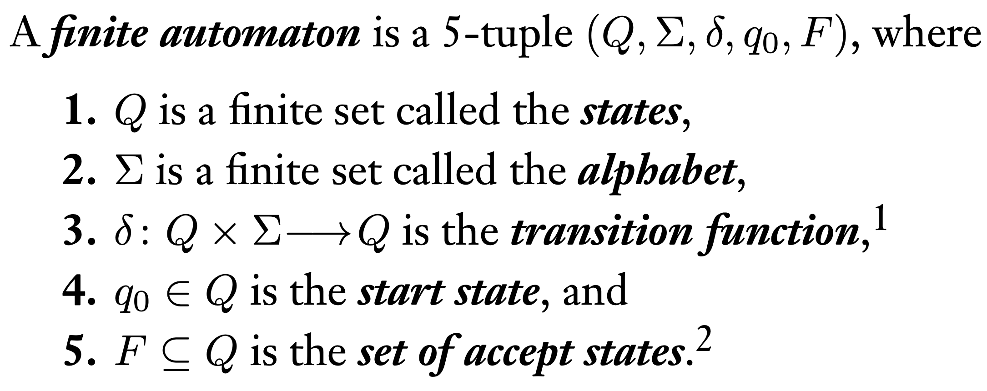
033.CSE105.NFAToDFA
Remember:
Def 1.5, section 1.1, pg35

Slide 37
Simulating NFA with DFA
Not quite a closure proof, but …
Proof:
Given name variables for sets, machines assumed to exist.
WTS state goal and outline plan.
Construction using objects previously defined + new tools working towards goal. Give formal definition and explain.
Correctness prove that construction works.
Conclusion recap what you've proved.

Slide 38
Simulating NFA with DFA
For any language recognized by an NFA, there is a DFA
that recognizes this language.
Proof:
Given A, a language recognized by N = (Q,Σ,δ,q0,F) a NFA
WTS there is some DFA M with L(M) = A
Construction
Correctness
Conclusion

Slide 39
Idea of construction
Track set of possible states NFA might be in.

Slide 40
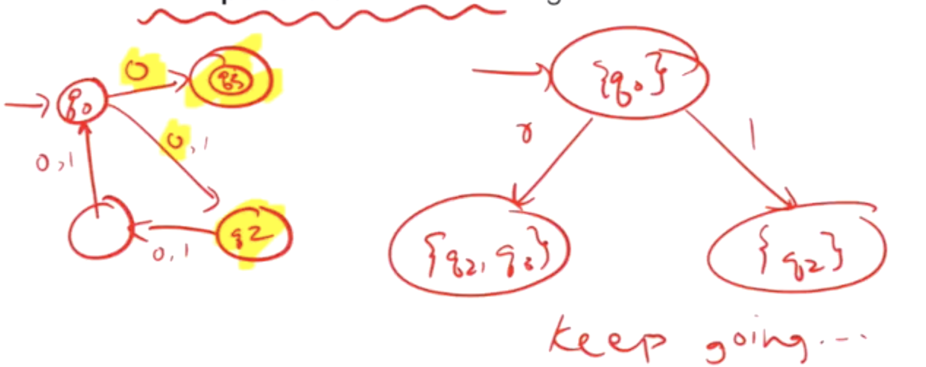
Idea of construction
Track set of possible states NFA might be in.

Slide 41
From NFA to DFA
Which states can this NFA be in before first input symbol is read?
q0
any state
q0, q1
q0, q4
q0, q1, q4

Slide 42



From NFA to DFA
Which states can this NFA be in before first input symbol is read?
q0
any state
q0, q1
q0, q4
q0, q1, q4

Slide 43
Subset construction
Given A, a language recognized by N = (Q,Σ,δ,q0,F) a NFA
WTS there is some DFA M with L(M) = A
Construction Define M = (Q', Σ, δ',q0', F') with
Q' = the power set of Q = { X | X is a subset of Q }
q0' = { states N can be in before first input symbol read }
F' = { }
δ' ( ) =

Slide 44



Subset construction
Given A, a language recognized by N = (Q,Σ,δ,q0,F) a NFA
WTS there is some DFA M with L(M) = A
Construction Define M = (Q', Σ, δ',q0', F') with
Q' = the power set of Q = { X | X is a subset of Q }
q0' = { states N can be in before first input symbol read }
F' = { }
δ' ( ) =

Slide 45
Subset construction
Given A, a language recognized by N = (Q,Σ,δ,q0,F) a NFA
WTS there is some DFA M with L(M) = A
Construction Define M = (Q', Σ, δ',q0', F') with
Q' = the power set of Q = { X | X is a subset of Q }
q0' = { q0 } U δ((q0, ε)) …
F' = { guarantee at least one computation is successful }
δ' ((X, x)) = { q in Q | q is in δ((r,x)) for some r in X or is accessible via spontaneous moves}

Slide 46
Key Notation and Definitions (033)
Construct DFA M from NFA N = (Q,Σ,δ,q0,F)
Build a state diagram for a DFA M.
Define M = (Q', Σ, δ',q0', F') with
Q' = the power set of Q = { X | X is a subset of Q }
q0' = { q0 } U δ((q0, ε)) …
F' = { guarantee at least one computation is successful }
δ' ((X, x)) = { q in Q | q is in δ((r,x)) for some r in X or is accessible via spontaneous moves}
Note: Single set in DFA are subsets of states in NFA.

Slide 47
034.CSE105.ExtraExample.mp4
Remember: (again)
The language of an NFA is the set of strings accepted by the NFA.
NFA and DFA must read/consume the entire input string before accepting or rejecting it.

Slide 48
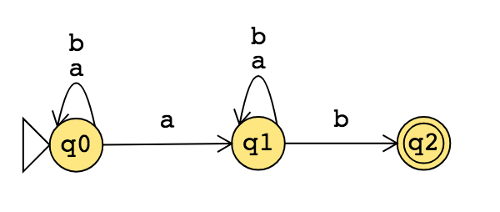
What is the language recognized by this NFA?

Slide 49
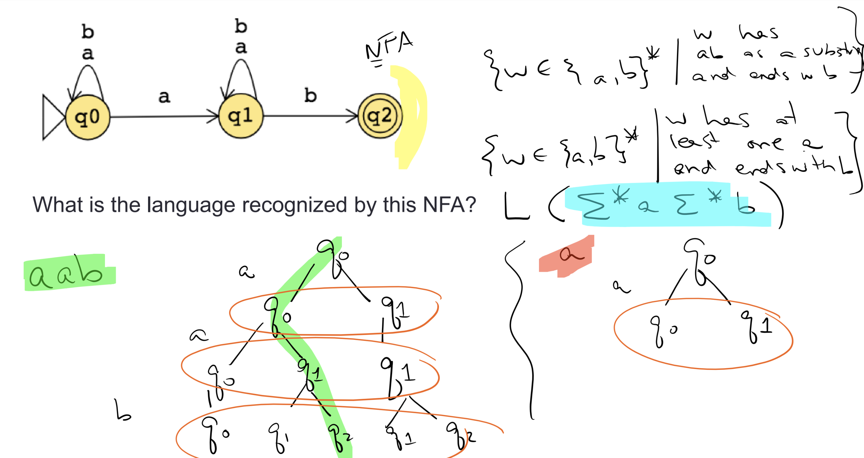

Slide 50
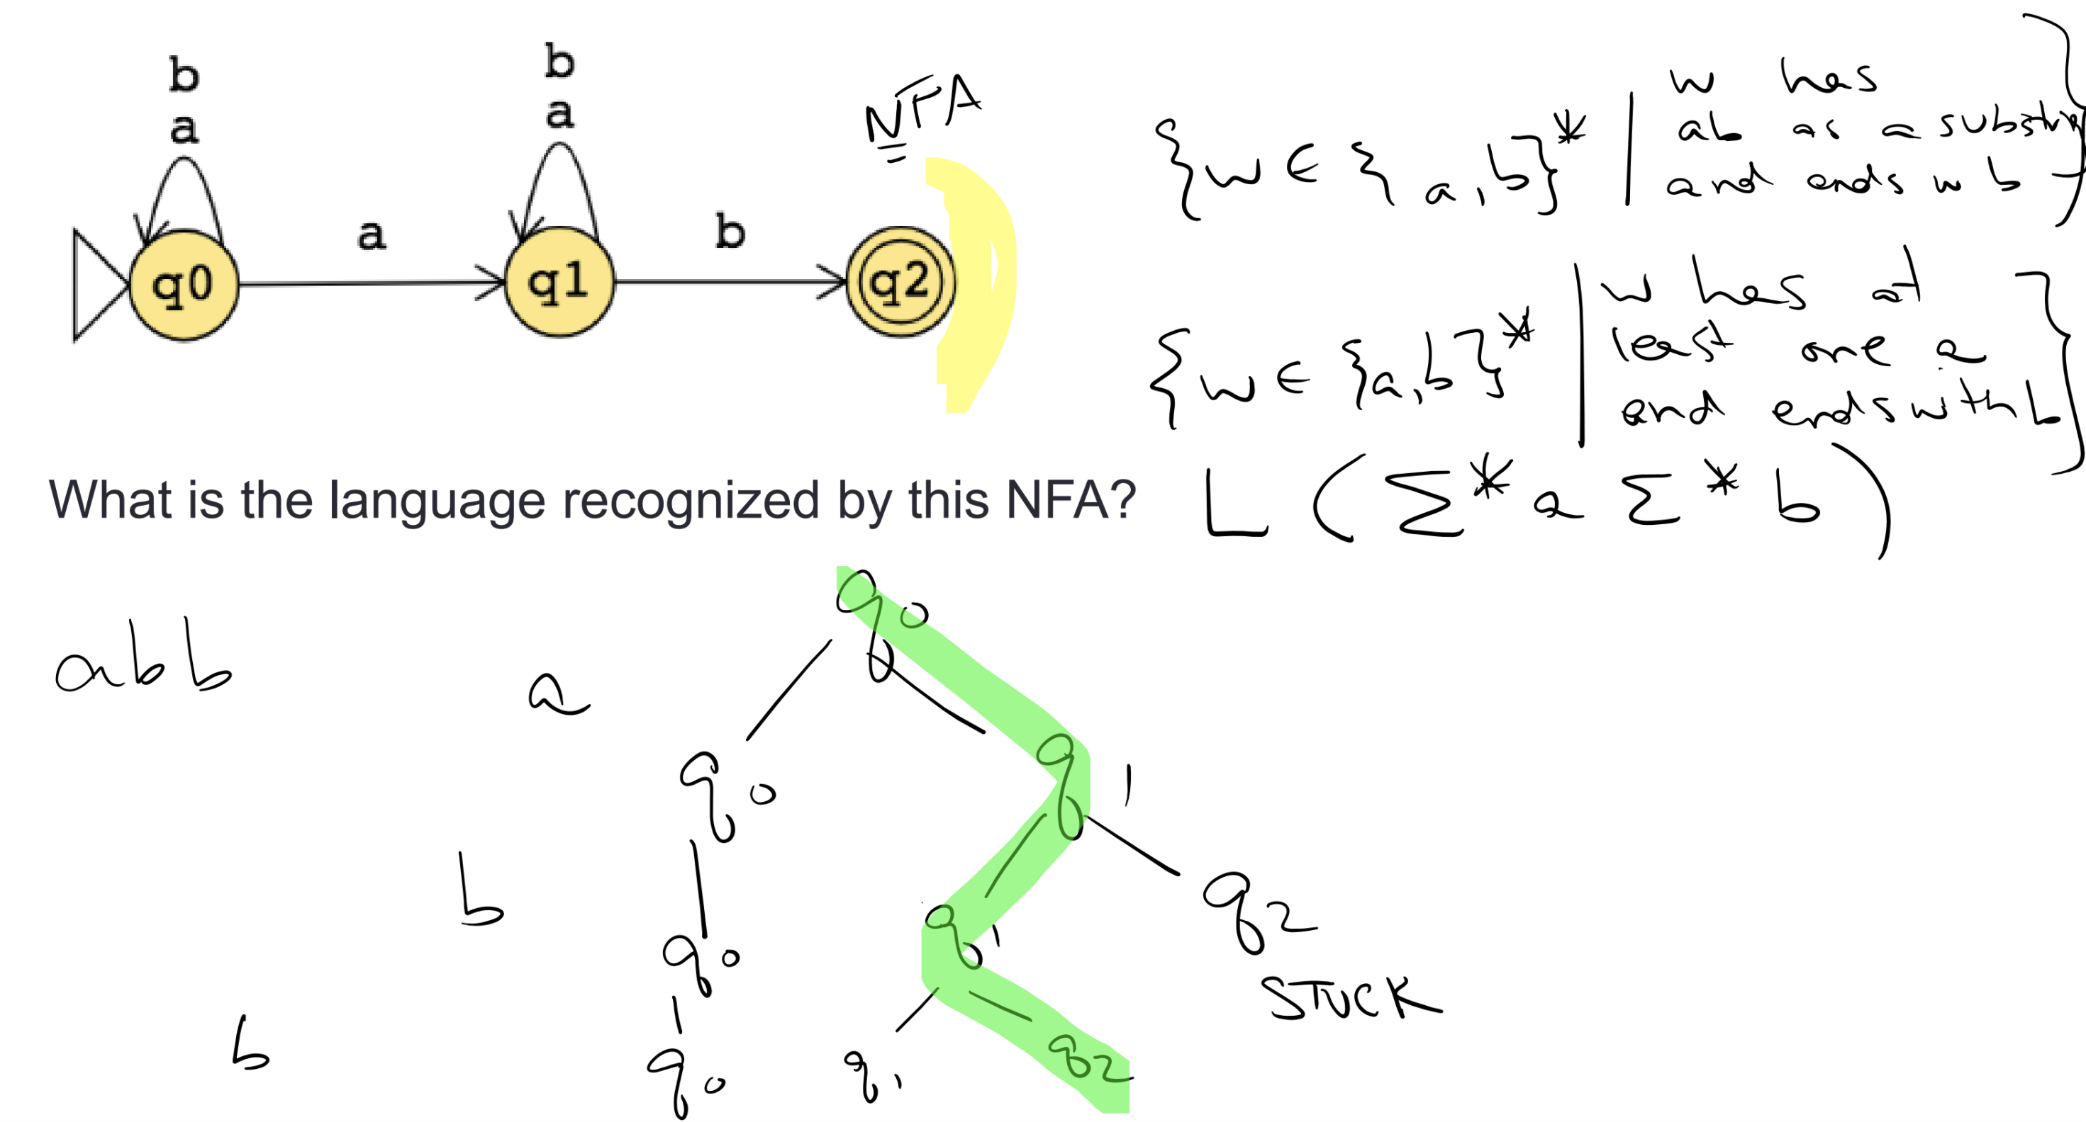

Slide 51
DFA equiv NFA
Theorem: For each language L,
L is recognized by some DFA
iff
L is recognized by some NFA

Slide 52
Idea of construction
Given A, a language recognized by N = (Q,Σ,δ,q0,F) a NFA
WTS there is some DFA M with L(M) = A
At each step of processing an input string, track set of possible states a computation of the NFA might be in.

Slide 54
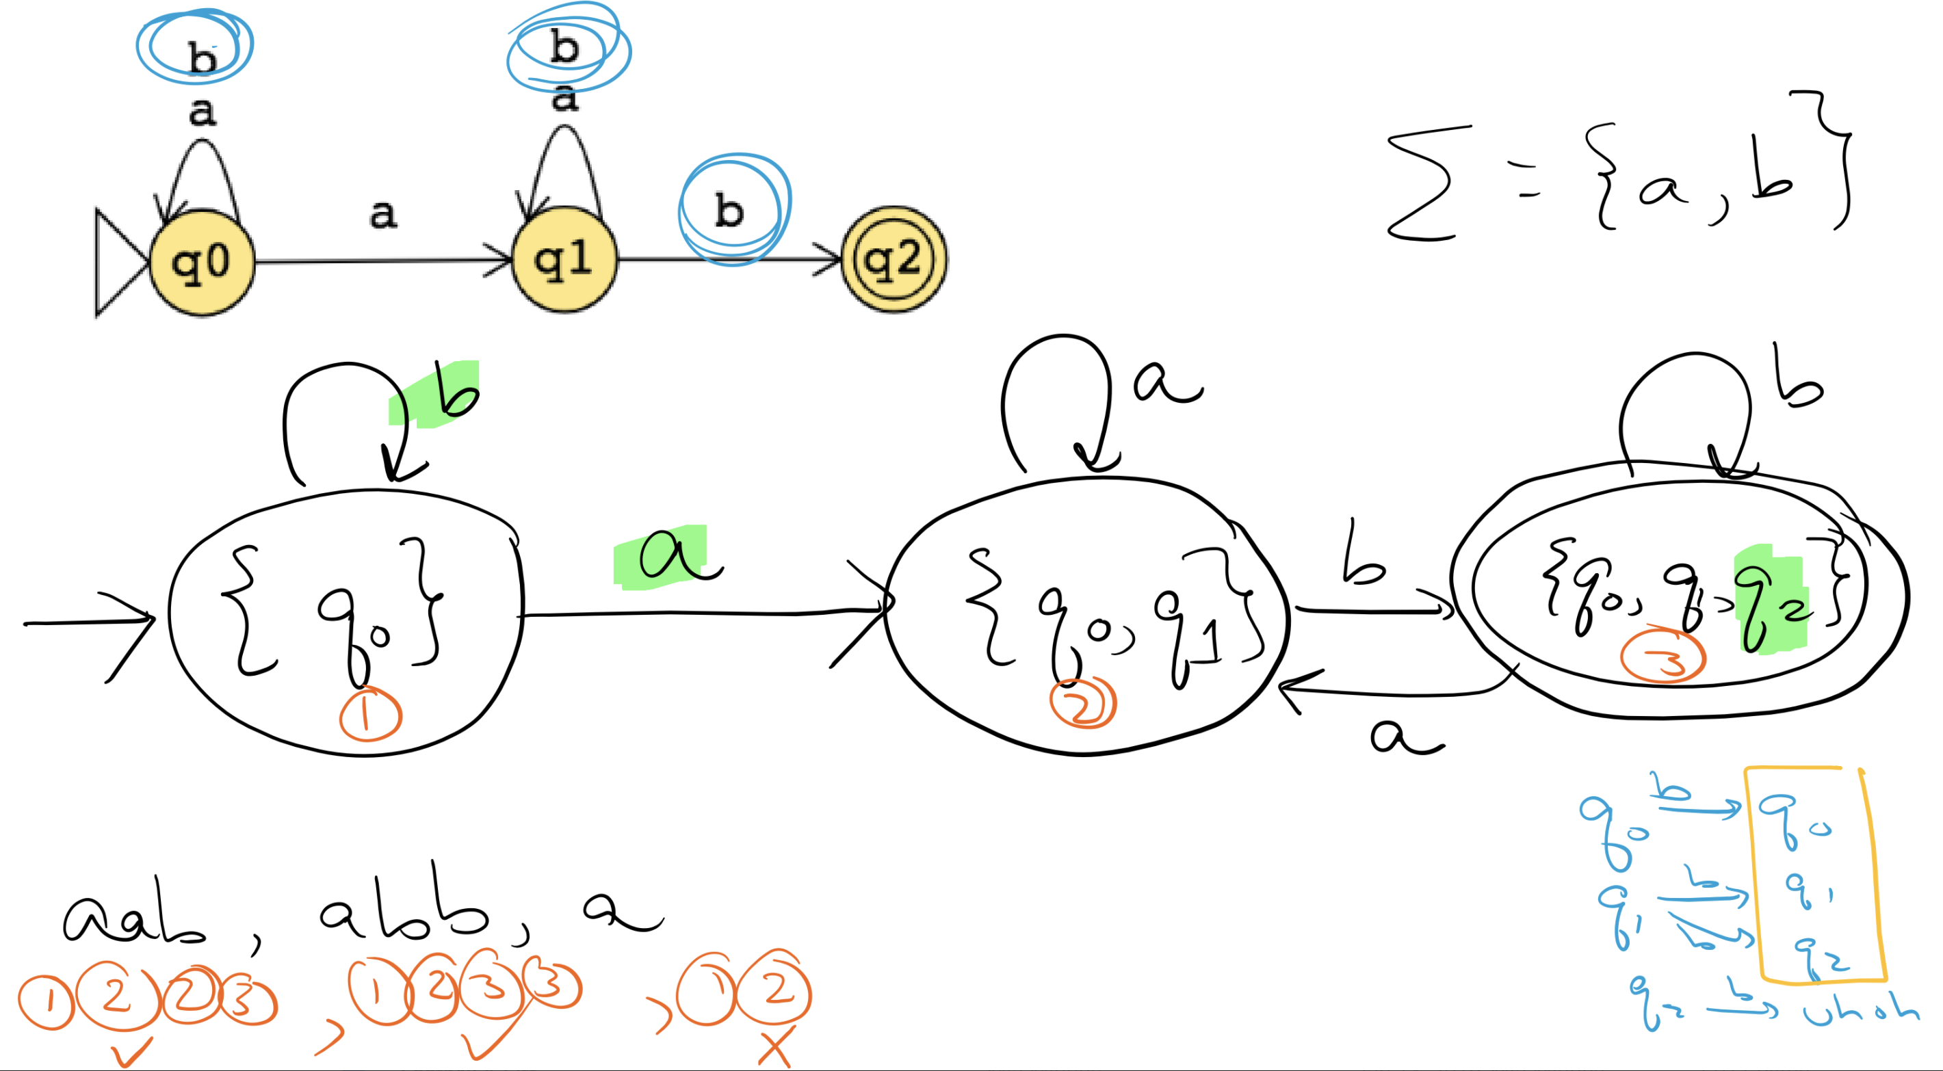

Slide 55
Key Notation and Definitions (034)
The equivalence of two machines means that they recognize the same language.
To convert NFA to DFA
Track the set of possible states a computation of the NFA might be in at each step in processing an input string.
Put the set of possible states as a new state in DFA. (e.g. state {q0, q1})

Slide 56
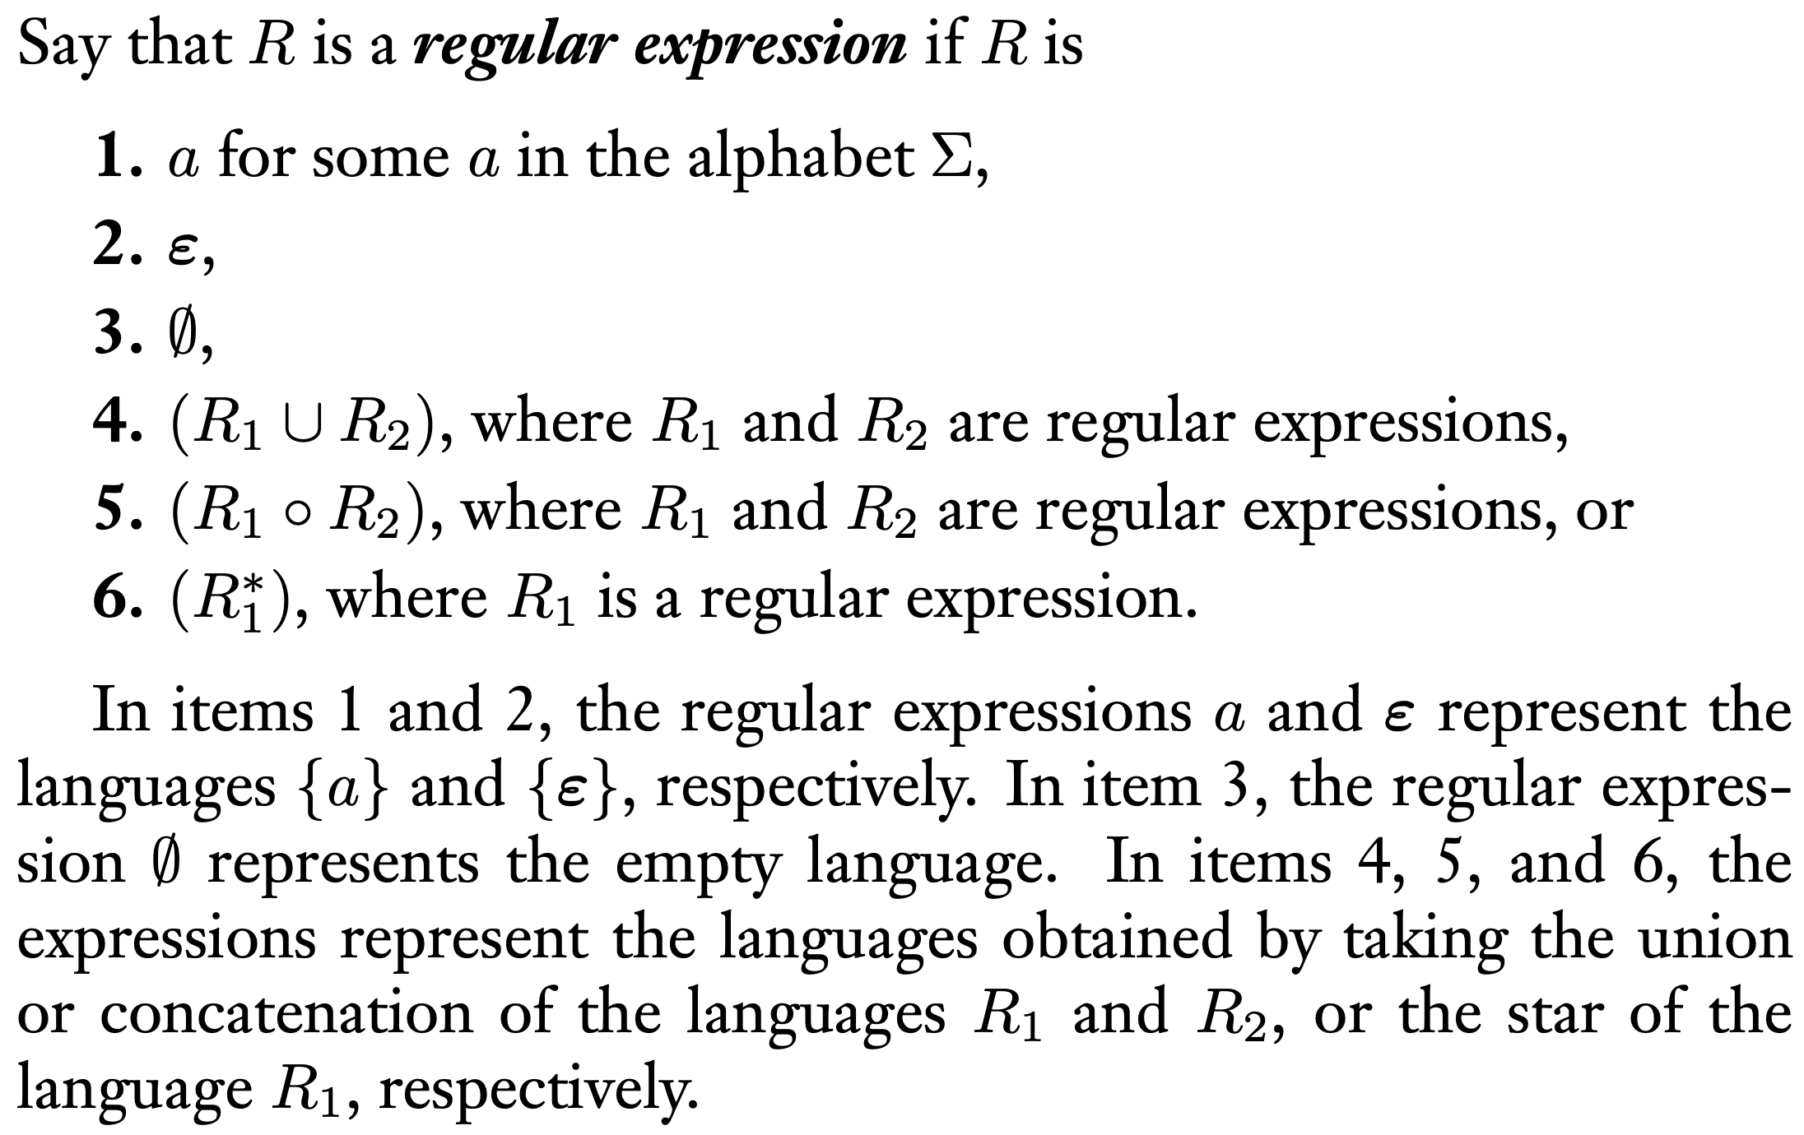
035.CSE105.DFAToRegExp.mp4
Remember:
Def 1.52, pg.64, section 1.3

Slide 57
From DFA to RegExp Sipser pp. 70-71
Trace possible paths from start state to accept state.
Intermediate machines (called Generalized NFA) can have regular expressions on transitions.
First
add new start state that has ε arrow to old start state
add new accept state that has ε arrows from old accept states (and ø arrows from nonaccept states)

Slide 58
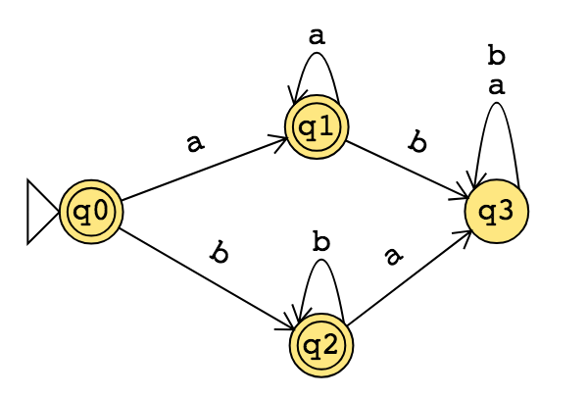

Slide 59
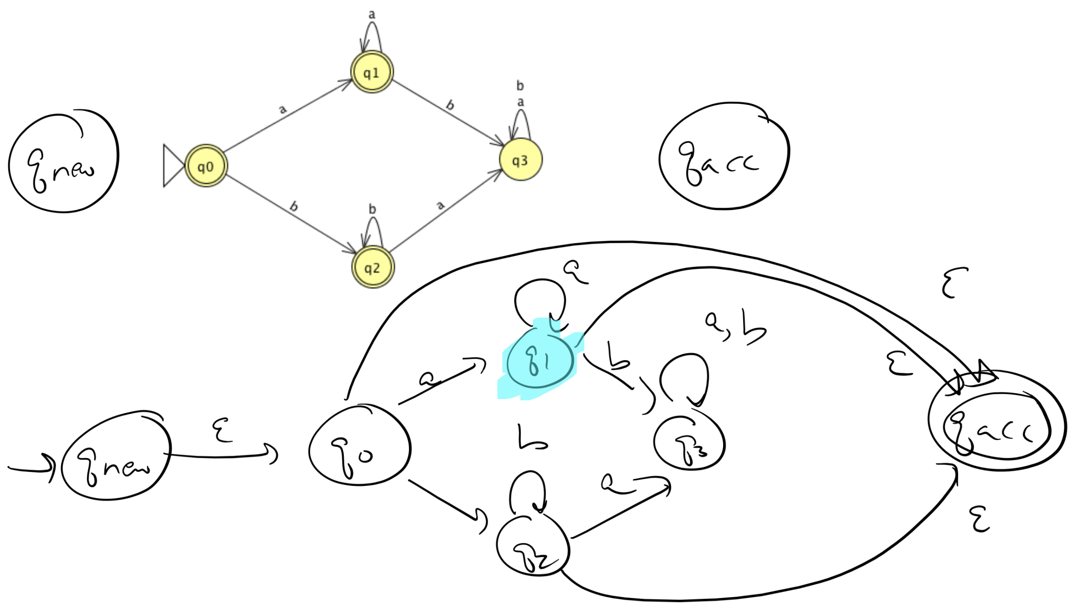

Slide 60
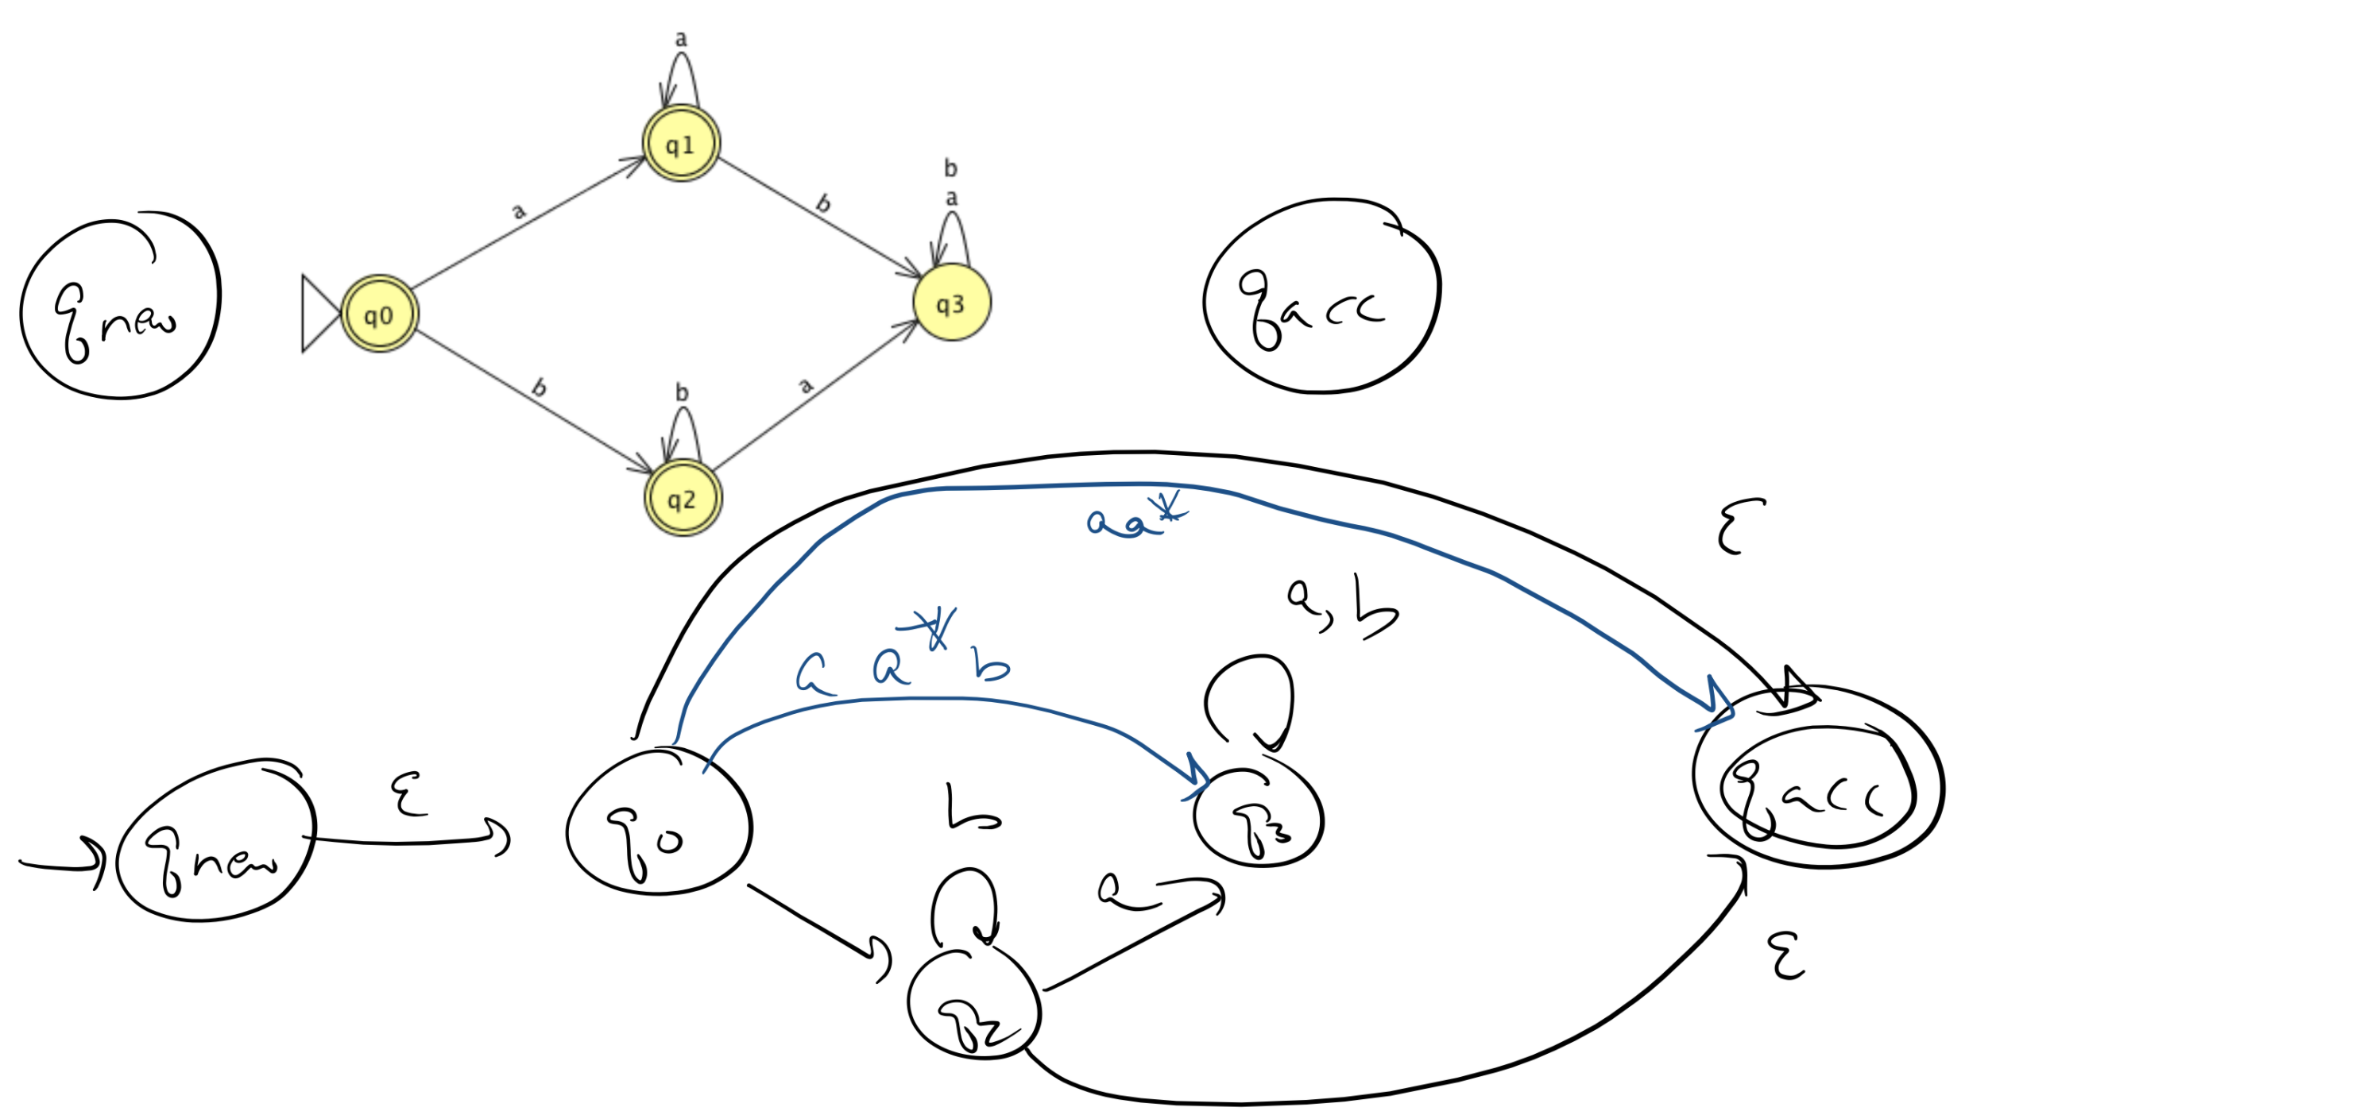

Slide 61
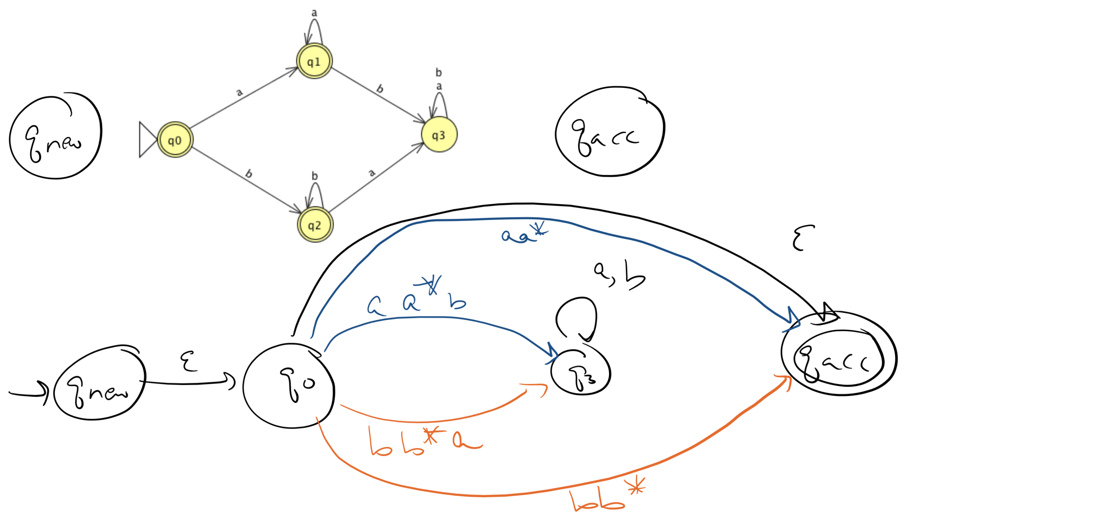

Slide 62
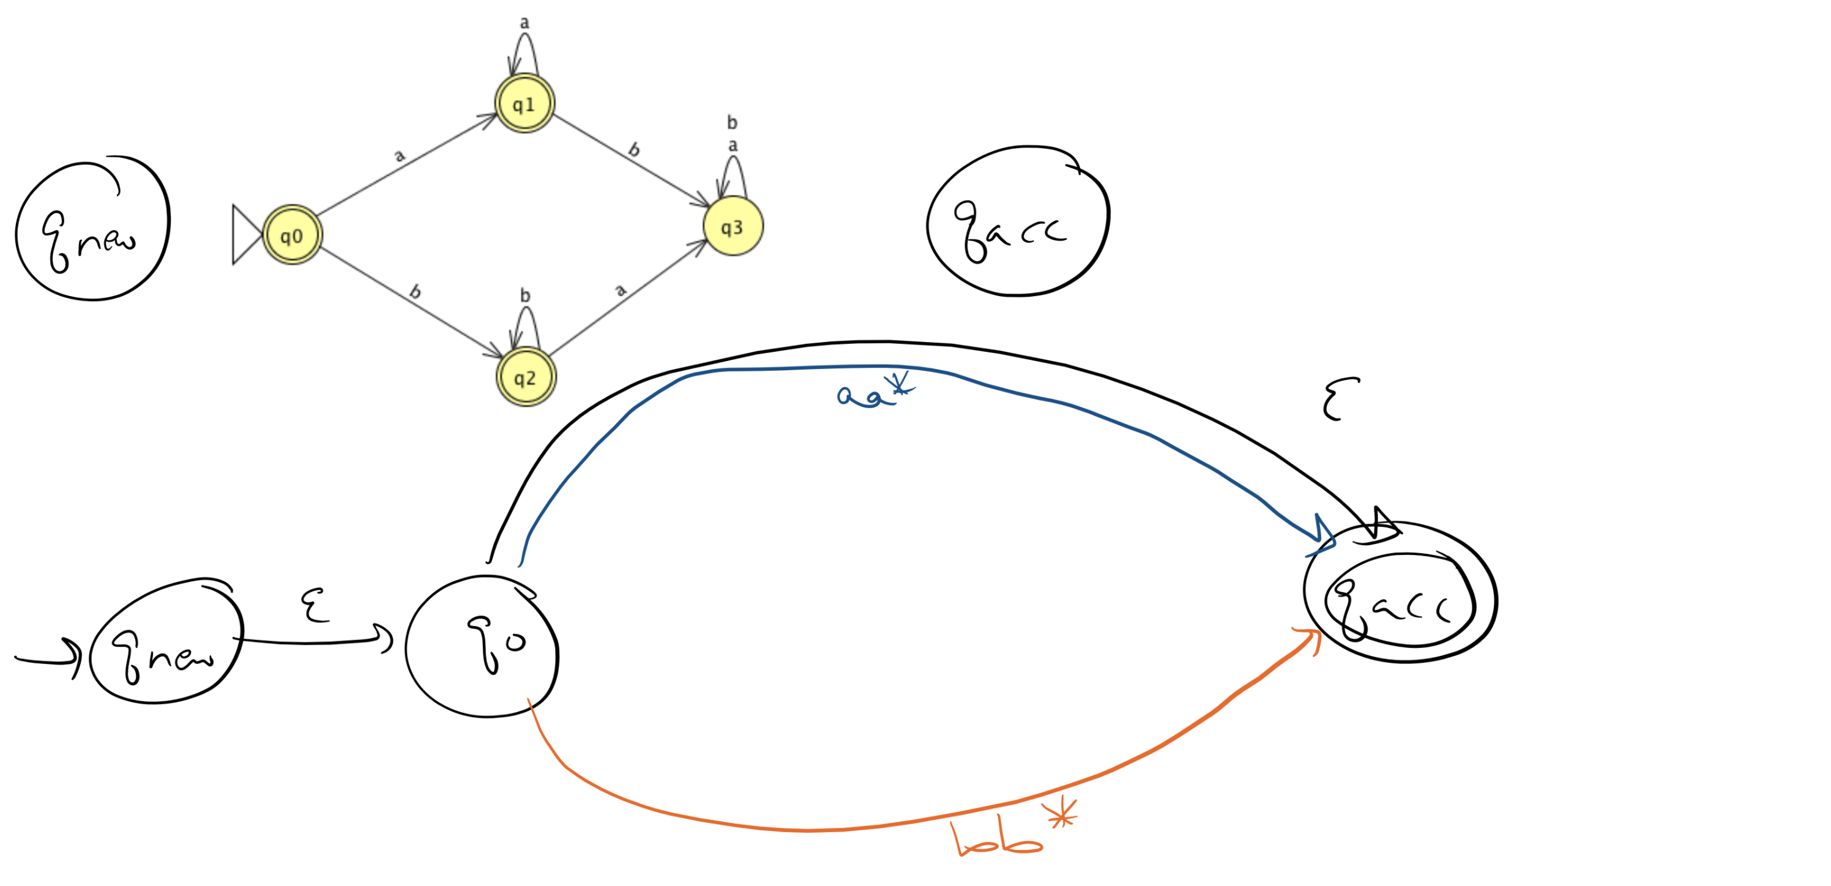

Slide 63
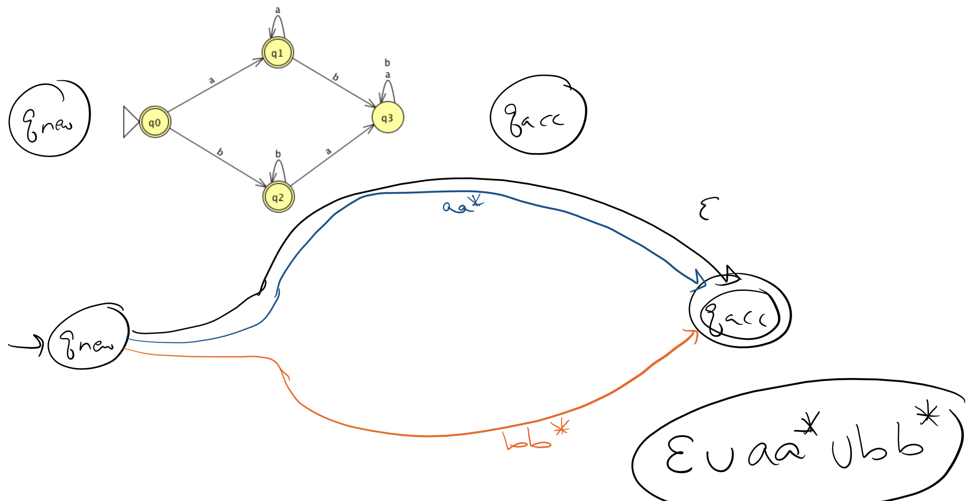

Slide 64
From DFA to RegExp
Remove one state at a time.
Restore automaton by modifying regular expressions on transitions that went through removed state.

Slide 65
Key Notation and Definitions (035)
From DFA to RegExp
Add new start state that has ε arrow to old start state
Add new accept state that has ε arrows from old accept states (and ø arrows from non-accept states)
Remove one state at a time.
Restore automaton by modifying regular expressions on transitions that went through removed state.
Union of path labels => Regular Expression

Slide 66
036.CSE105.RegExpToNFA.mp4

Slide 67
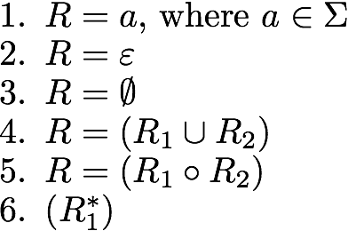
From RegExp to DFA
Base cases
Structural induction!
Build DFAs (or NFAs) corresponding to base cases in inductive definitions of regular expressions.
Describe constructions for DFAs corresponding to each of the inductive steps: union, concatenation, Kleene star.
Inductive steps

Slide 68
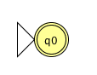
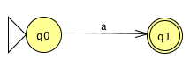
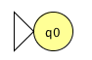
Structural induction Thm 1.45, 1.47, 1.49 pp 59-62
Base cases
#1 #2 #3
Which of these recognizes L(ø) ?
NFA #1
NFA #2
NFA #3
More than one of the above
None of the above

Slide 69
Structural induction Thm 1.45, 1.47, 1.49 pp 59-62
Base cases
Inductive steps
ε
ε
Union Concatenation Kleene star
ε
M1
ε
M2
Input
ε
Input
Input
M
M1
M2

Slide 70
Example
a*(ab)*

Slide 71
DFA equiv NFA equiv RegExp
Theorem: For each language L,
L is recognized by some DFA
iff
L is recognized by some NFA
iff
L is described by some regular expression

Slide 72
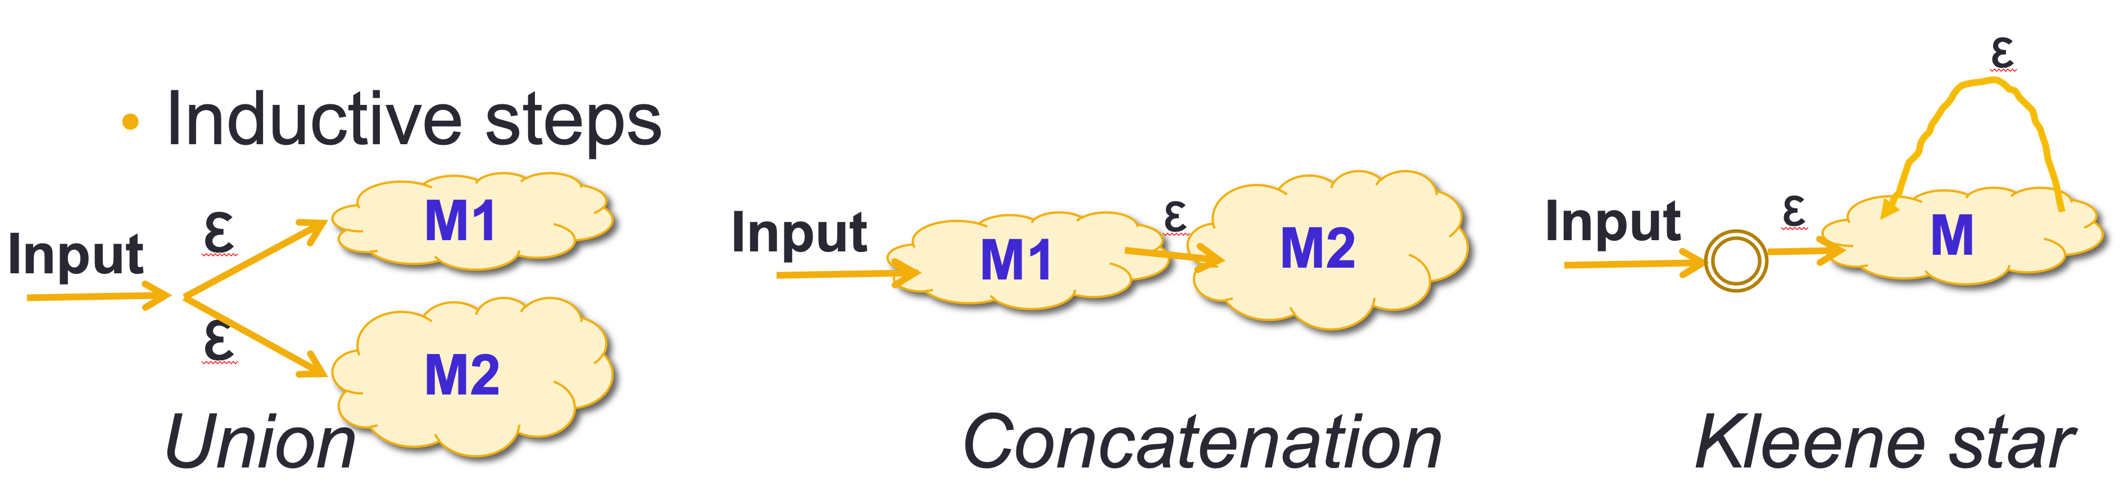
Key Notation and Definitions (036)
Theorem: For each language L,
L is recognized by some DFA
iff
L is recognized by some NFA
iff
L is described by some regular expression

Slide 73
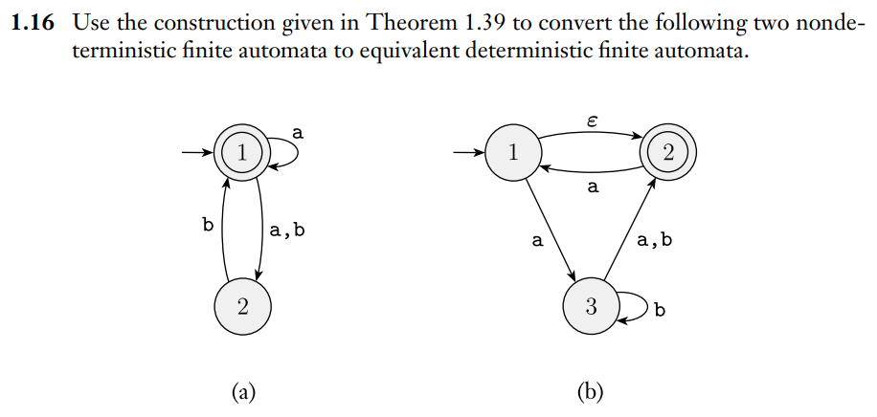
Converting NFA to DFA
Ch. 1 Exercises pg. 86
Example 1

Slide 74
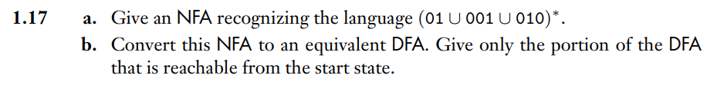
Constructing an NFA and Converting to DFA
Example 2
Ch. 1 Exercises pg. 86

Slide 75
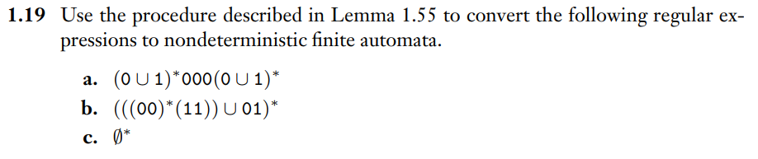
Converting RegExp to NFA
Example 3
Ch. 1 Exercises pg. 86
See Lemma 1.55 on pg. 67

Slide 76
Wednesday FAQ (033-036)
Q: "What are the main differences between DFA and NFA?"
A: In a DFA, we are required to have exactly 1 transition from each state for each symbol in the alphabet. In an NFA, we don't have to follow this rule. We can also read the empty string in a transition in an NFA, and we can't do that in a DFA. Both DFAs and NFAs have their formal definitions represented as a 5-tuple. In a DFA, the output of the transition function is a state, and in an NFA, the output of the transition function is a set of states.

Slide 77
Wednesday FAQ (033-036) cont.
Q: "Why do we include the ε arrows in building NFAs from regular expressions? The resulting NFAs are much more complicated than they need to be, aren't they?"
A: The constructions in the inductive algorithm work in general and don't include the optimizations that sometime lead to more compact NFAs.

Slide 78
Friday
Videos 037-039
Today’s learning goals
Explain the limits of the class of regular languages
Identify some nonregular sets
Justify why the Pumping Lemma is true
Today’s textbook sections
Sipser 1.4 Introduction (page 77)

Slide 79
037.CSE105.NonregularSetsIntroduction.mp4
Remember:
Language = a set of strings over some alphabet

Slide 80
Regular sets
Theorem: For each language L,
L is recognized by some DFA
iff
L is recognized by some NFA
iff
L is described by some regular expression
If these conditions apply, L is called regular

Slide 81
All roads lead to … regular sets?
Are there any languages over {0,1} that are not regular?
Yes: a language that is recognized by an NFA but not any DFA.
Yes: there is some finite language over {0,1} that is not described by any regular expression.
No: all languages over {0,1} are regular because that's what it means to be a language.
No: for each set of strings over {0,1}, some DFA recognizes that set.
None of the above.

Slide 82
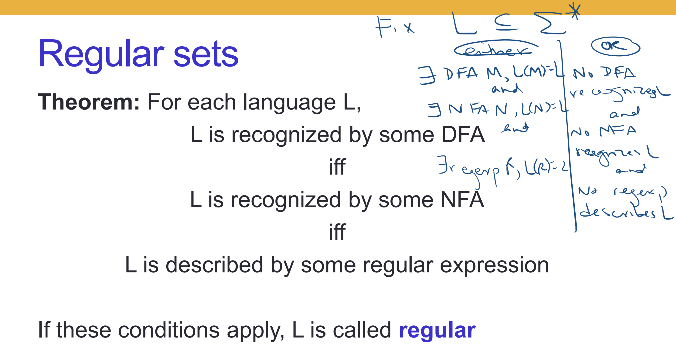

Slide 83
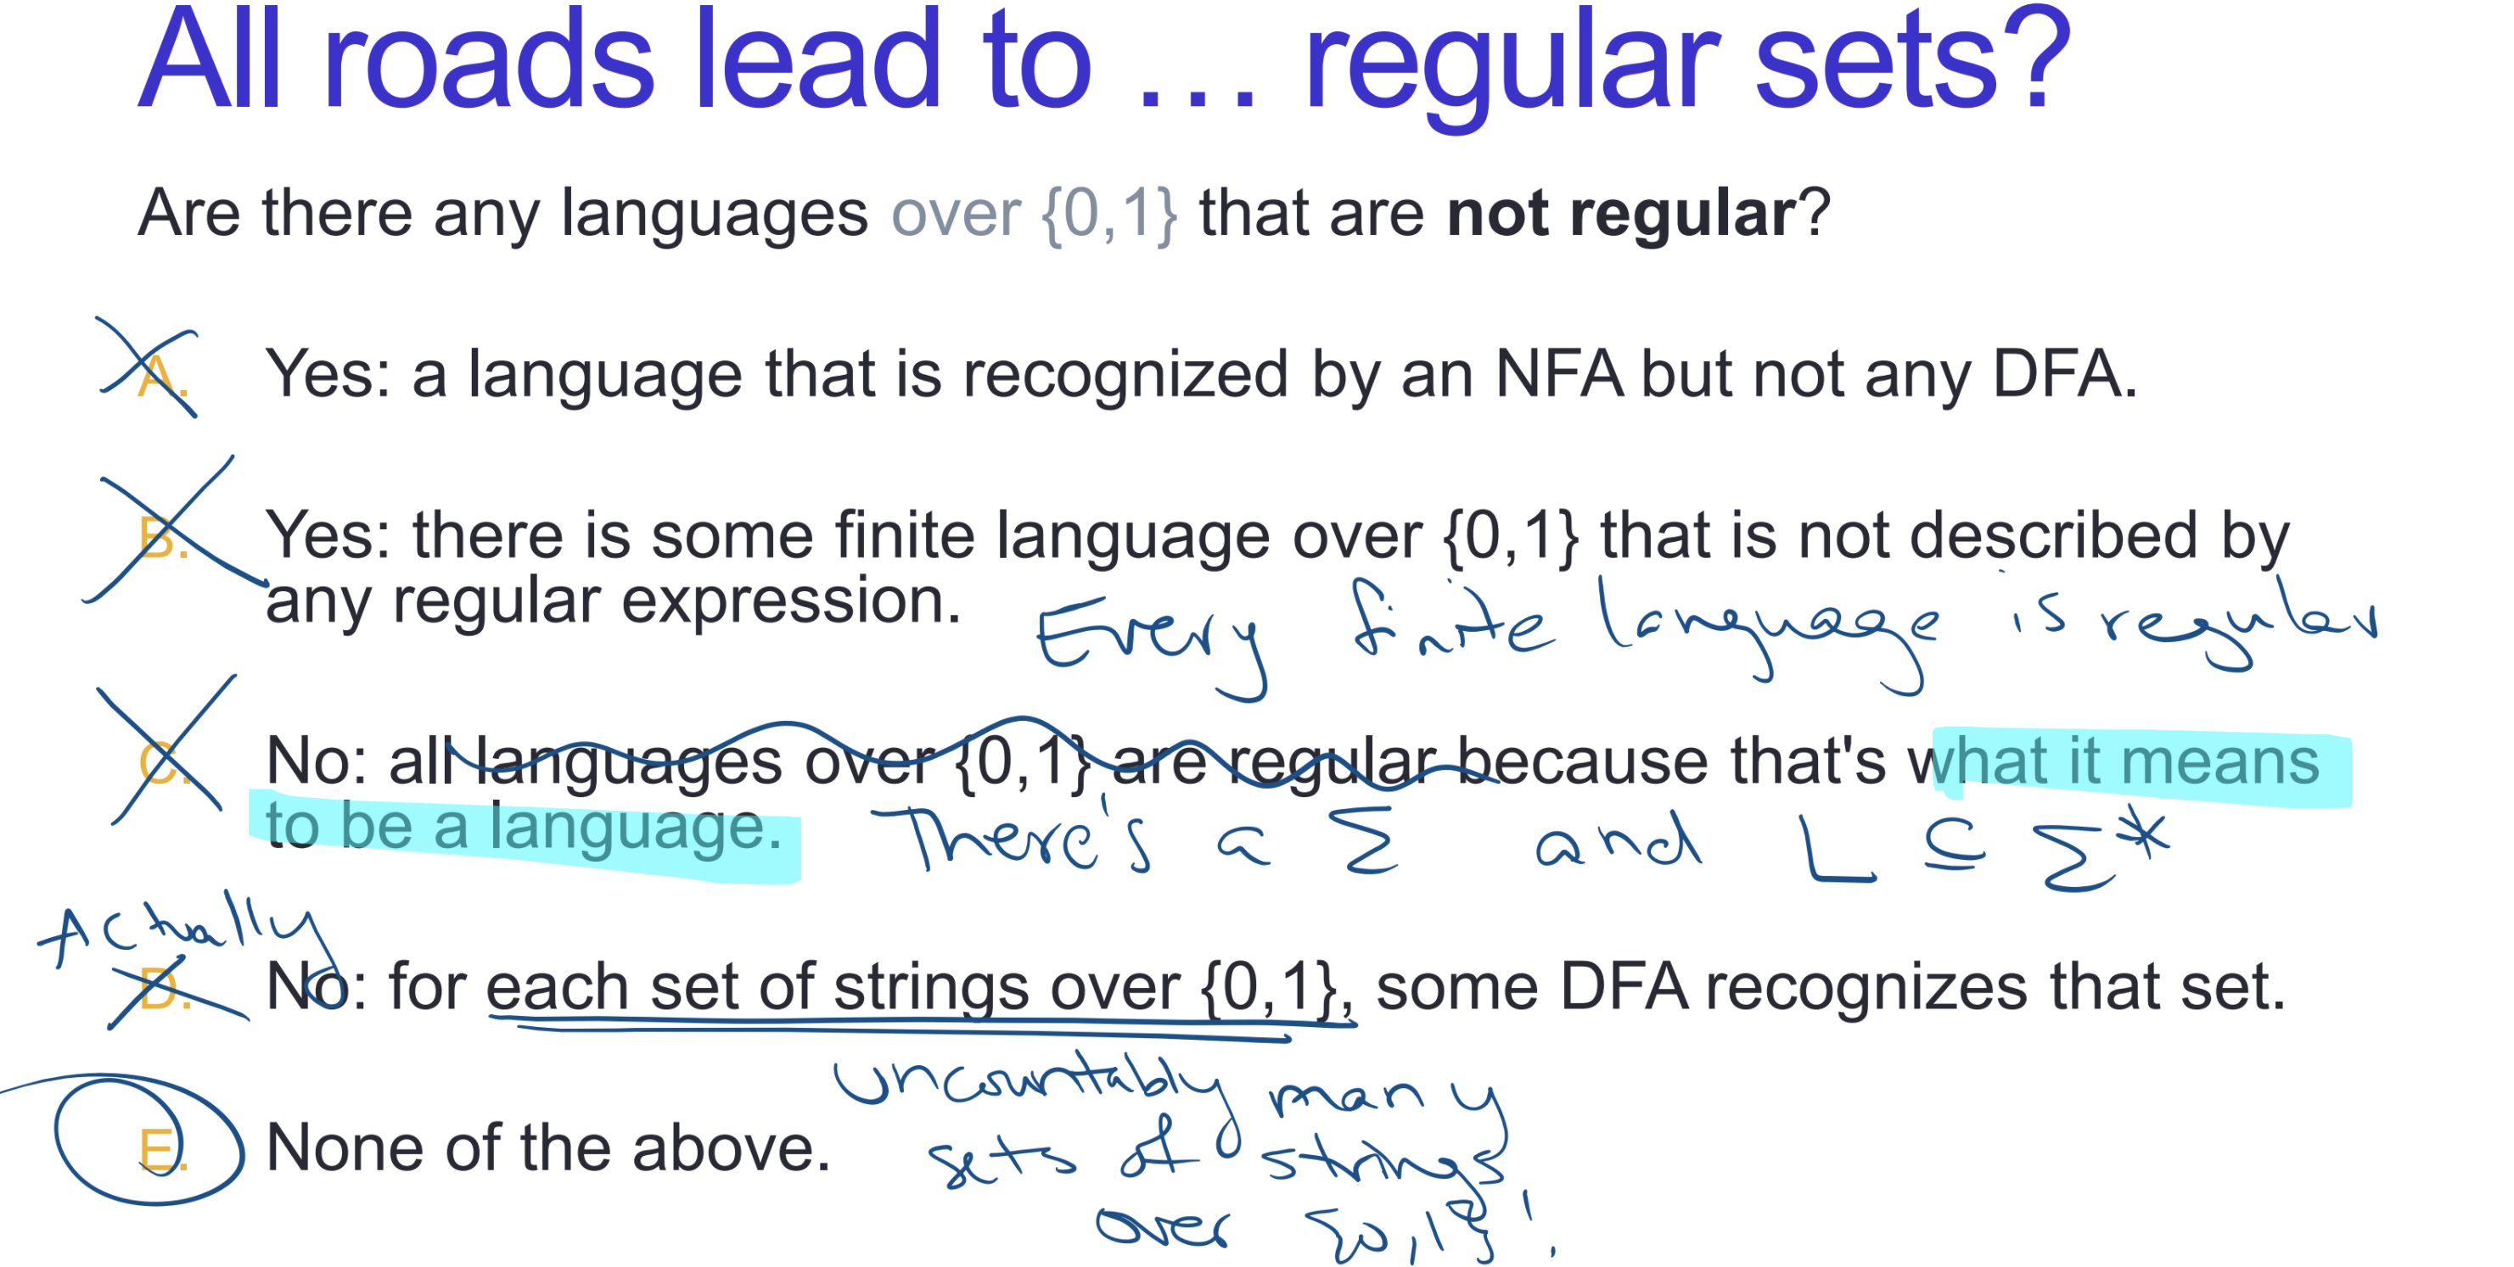

Slide 84
Key Notation and Definitions (037)
Language = a set of strings over some alphabet.
Every finite language is regular.
There are uncountably many sets of strings over {0,1}.
There are sets that are too complicated to be described by regular expressions.

Slide 85
038.CSE105.NonregularSetsCardinalityArguments.mp4
Remember:
A set is countably infinite if it has a one-to-one correspondence with the natural number set, N.
The cardinality of a set is a measure of the “number of elements” of the set.
Any set that is countably infinite has the same cardinality as the set of the natural numbers, N.

Slide 86
But where to start?

Slide 87
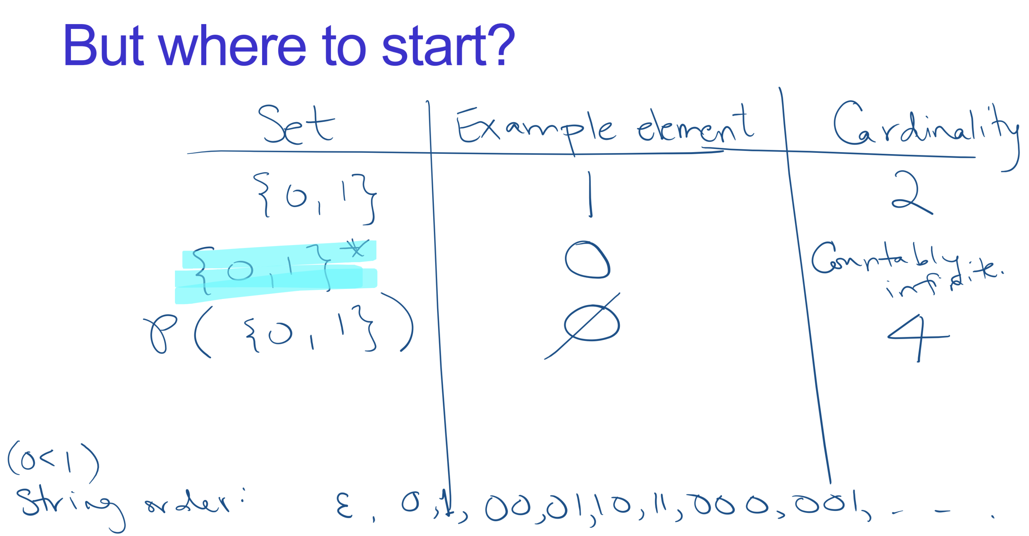

Slide 88
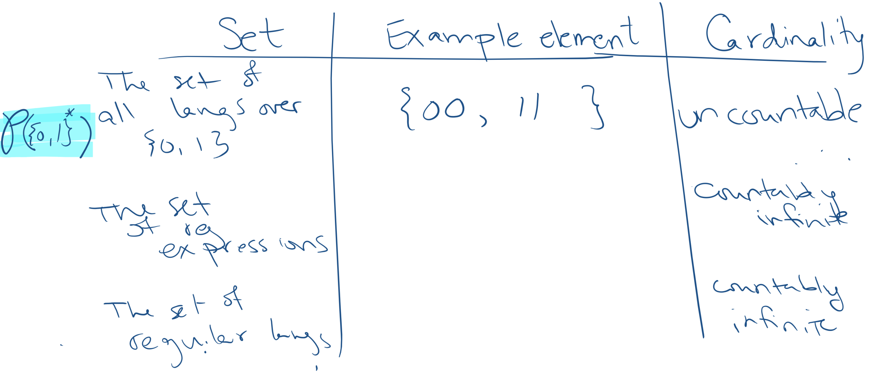
But where to start?

Slide 89
Counting regular languages over {0,1}
| { regular languages} | ≤ | { regular expressions } |
Each regular expression is a finite string over the alphabet
{ 0 , 1 , ε , ø , ( , ) , U , * }
The set of strings over an alphabet is countably infinite.
Conclude: countably infinitely many regular languages.

Slide 90
Key Notation and Definitions (038)
The set of all languages over {0,1} = P({0,1}*) is uncountable.
Each regular expression is a finite string over the alphabet
{ 0 , 1 , ε , ø , ( , ) , U , * }
The set of strings over an alphabet is countably infinite.
There are countably infinitely many regular languages.
There are countably infinitely many regular expressions.

Slide 91
039.CSE105.NonregularSetsStrategies.mp4
Remember:
The contrapositive of a statement has its antecedent and consequent inverted and flipped.
i.e. The contrapositive of P → Q is !Q →!P

Slide 92
Where we stand
Fact 1: There exist nonregular languages.
Fact 2: If we know some languages are nonregular, we can conclude others must be too.
But, we don't have any specific examples of nonregular languages.
Yet.

Slide 93
Proving nonregularity
How can we prove that a set is nonregular?
Try to design a DFA that recognizes it and, if the first few attempts don't work, conclude there is none that does.
Prove that it's a proper subset of some regular set.
Prove that it's the union of two regular sets.
Prove that its complement is not regular.
I don't know.

Slide 94
Proving nonregularity
How can we prove that a set is nonregular?
Try to design a DFA that recognizes it and, if the first few attempts don't work, conclude there is none that does.
Prove that it's a proper subset of some regular set.
Prove that it's the union of two regular sets.
Prove that its complement is not regular.
I don't know.

Slide 95
Bounds on DFA
in DFA, memory = states
Automata can only "remember"…
…finitely far in the past
…finitely much information
If a computation path visits the same state more than once, the machine can't tell the difference between the first time and future times it visited that state.

Slide 96
Key Notation and Definitions (039)
We can prove that if a language is nonregular, its complement is also nonregular.

Slide 97
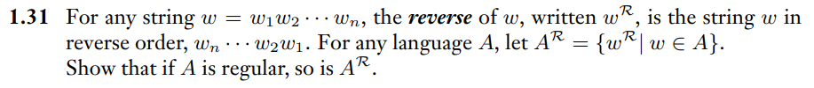
Proof of closure of class of regular languages, using NFA
Ch. 1 Problems pg. 88

Slide 98
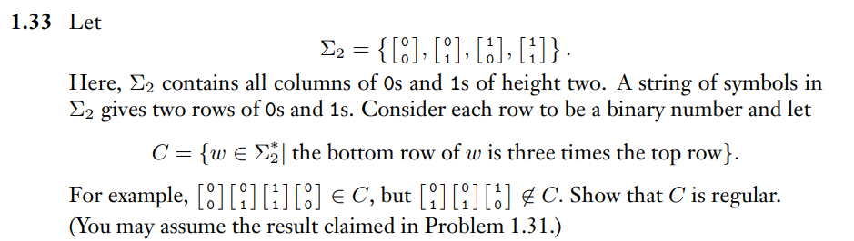
A More Complex Regular Language
Example 2
Ch. 1 Problems pg. 89

Slide 99
Friday FAQ (037-039)
Q: "Are all nonregular languages infinite?"
A: Yes, if a language was finite, then it would be regular, since all finite languages are regular.
Q: "Are most languages nonregular?"
A: Yes, only a small subset of languages are regular. There is a countably-infinite amount of regular languages and an uncountably-infinite amount of nonregular languages.

Slide 100
Friday FAQ (037-039) cont.
Q: "Why can't every language be recognized by a DFA or NFA?"
A: DFAs and NFAs have limitations. The only memory that we would have is the states themselves, so once we read a symbol from the string and transition to a state, there would be no way for us to go back and get any information about it. Some languages may have strings that are based on patterns which would require us to know some information about other symbols in the string. DFAs and NFAs would not be sufficient for this.

